Slide 1
IBM DATA ANALYSIS PROJECT
(SUPERSTORE DATA)
-PARITOSH DAS

Slide 2
INTRODUCTION:
A multinational retail company has been making good sales from 2014 to 2017, but their recorded profits do not tally with the increasing amount of sales they have made throughout the period. As an initiative of the company to keep increasing their sales, whilst maximizing their sales as best as possible, the campaign titled **'Operation Increase Sales and Profit'(OISP)** was launched.
As a part of the campaign initiative, a Data Analyst is required to analyze the dataset that contains their four year daily sales records to draw insights from their "sitting" data before the management team of the company can take any actionable decision with regards to the campaign.

Slide 3
MY ROLE:
To analyze the given data and advise management on what to do to increase sales and profit as intended in the campaign by outlaying the analytical steps inline with CRISP-DM(Cross Industry Standard Process for Data Mining)steps, asking the necessary questions and providing answers based on the data.
Submit statistical summaries of the key variables considering the aim of the campaign to management including visualizations and a report on my findings.

Slide 4
STEPS FOLLOWED:
Checked the summary statistics to identify any inconsistencies or outliers in the data.
Removed any duplicate records to ensure a high level of data accuracy.
Adding new columns to the dataset to capture additional information and insights.
Performed advanced techniques such as data imputation, outlier detection and handling, and data normalization to further improve the quality of the data

Slide 5
ANALYSIS INSIGHTS AFTER EDA
(In Graphs)

Slide 6
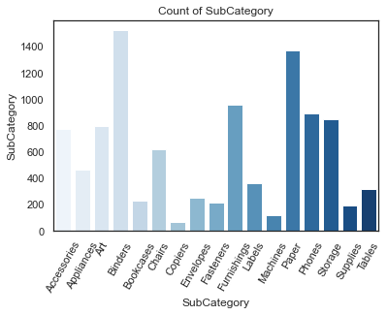
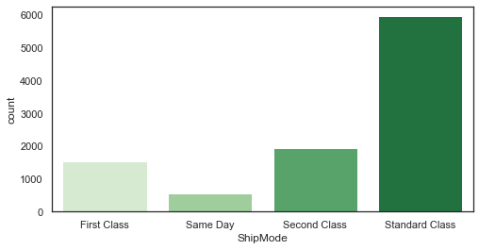
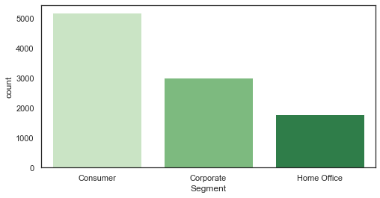
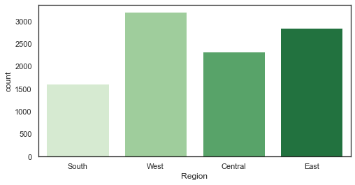
Count of subcategory Most Preferred ship mode
Segment Region

Slide 7
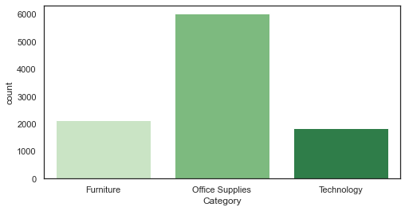
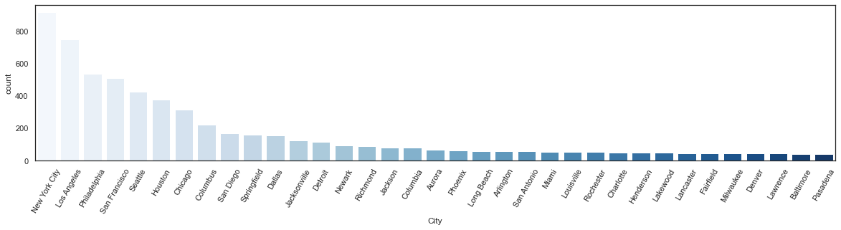
Category
City

Slide 8
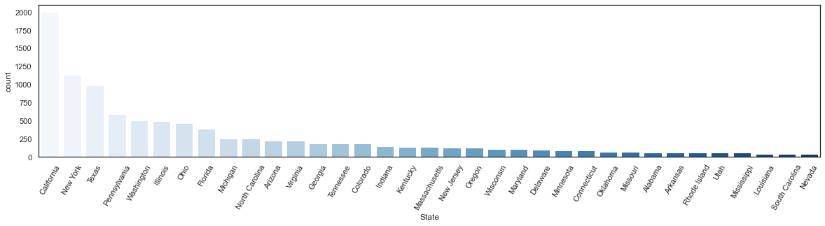
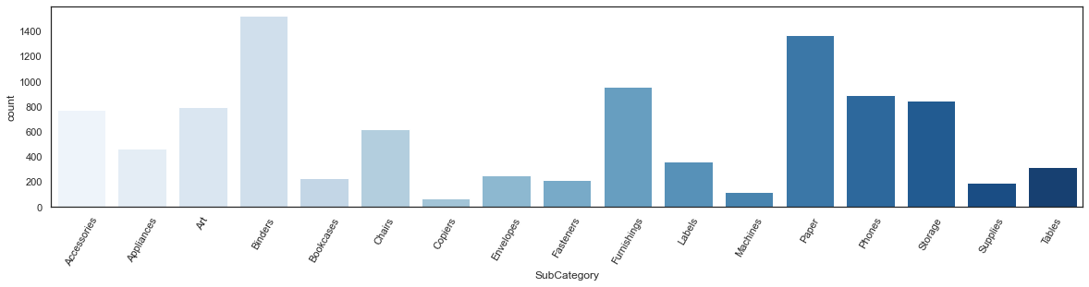
State
Subcategory

Slide 9
FINDINGS, RECOMMENDATIONS AND CONCLUSIONS

Slide 10
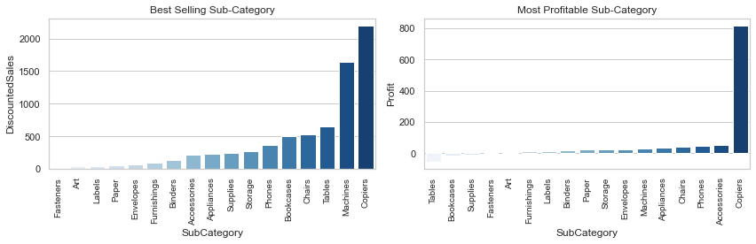
On analyzing the Super Store's sales and profitability data, it was found that the Technology sub-category and specific products such as Phones and Chairs are our highest selling and most profitable items. To offset losses from less profitable products such as Bookcases and Tables, I recommend bundling them with the high-performing items.
Conclusion-1:
For customers looking for a home office setup, I suggest creating a package deal that includes a variety of office essentials such as a table, chairs, phone, copiers, storage, labels, fasteners, and bookcases. This is a great option for customers who are busy and may not have the time to select individual products.
To address the issue of losses from selling Supplies, Bookcases, and Tables, I recommend considering dropping these products from our catalog or renegotiating with suppliers for a cheaper price.

Slide 11
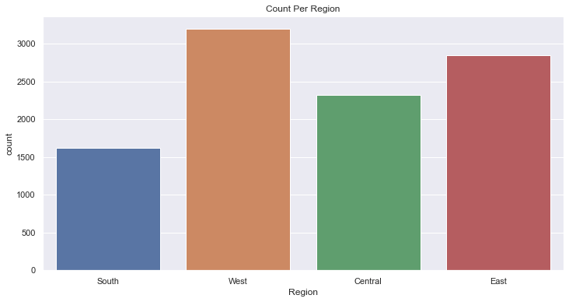
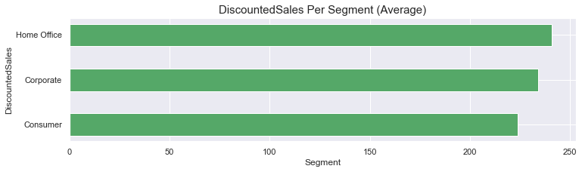
Our customer base is primarily made up of Consumer and Corporate segments, which make up over 70% of our customers. To target these segments, I suggest offering special promotions and bundles for mass Consumer and Home Offices in the top 10 cities with the highest sales, and sending promotional emails or flyers to customers in the East and West regions.

Slide 12
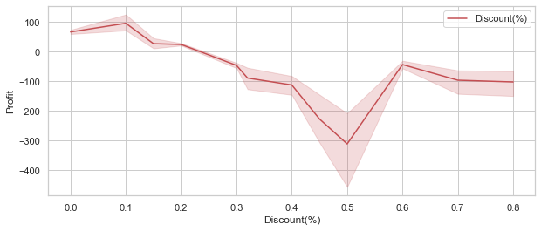
The main reason for losses is discounts. To improve this, I recommend offering more discounts during festival seasons, as this will result in more sales. During these seasons, the discount rate is recommended to be not more 20% as more than a 20% discount brings in great losses.
Conclusion-2:
Additionally, the home office segment needs improvement. In some cities, we have fewer sales, which may be due to a lack of awareness. Advertising in these cities may help increase sales. For advertising strategy, in the event that the company wants to run product package promos, It is advised that the most common items that are usually bought together to inform the company's decision.

Slide 13
GitHub link:
https://github.com/paritosh-das/IBM-DATAANALYSIS-PROJECT

Slide 14
THANK YOU

